Slide 1

Predictive Model of Location for an Individual based on Day, Time and Weather
Makayla Slick, Dana Sylvester

Slide 2

Background Information
Elementary school → middle school → high school → freshman year roommates
Consent was acquired
Writing both and testing the mean squared errors
Neural network highly inaccurate for our data or what we wrote
Comparison of Madi’s schedule and predicting if she would be skipping class depending on the temperature high on a given day.
Data is skewed for anonymity

Slide 3

Methods and Execution
Researched other people creating predictive models using location data
Deciding how to collect the data
Airtag, Tile, Find My iPhone location data, GPS tracking device ($$), Life360
Deciding whether or not to use a neural network or a random forest regressor
Pro Random Forest Classifier:
Easier to interpret and understand.
Robust to overfitting.
Requires less data preprocessing (ie. handling missing values).
Handles categorical data directly
Con Random Forest Classifier:
Can be less accurate for very complex patterns
Slower to train and predict as the number of trees grows

Slide 4
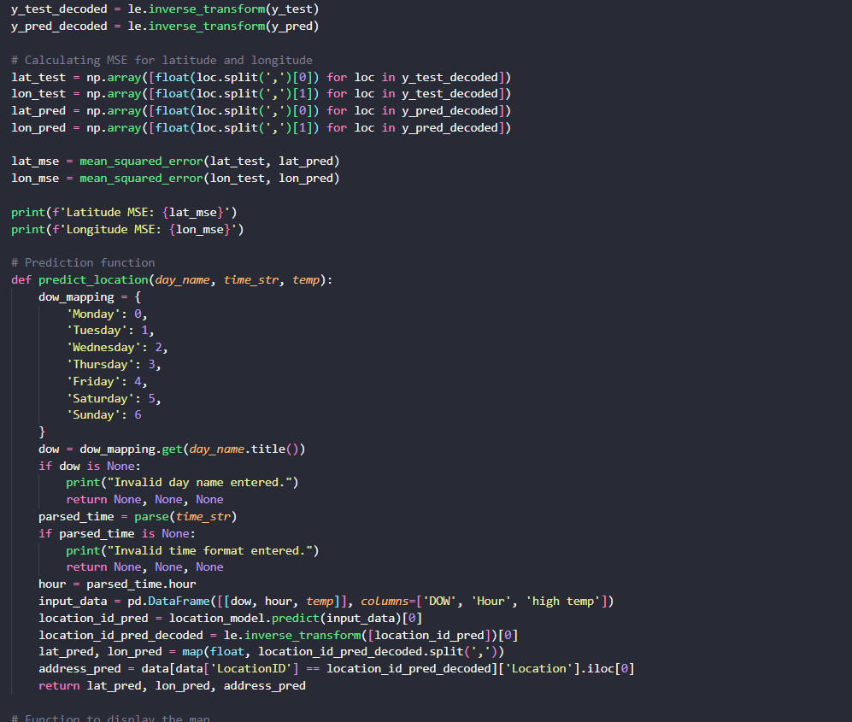
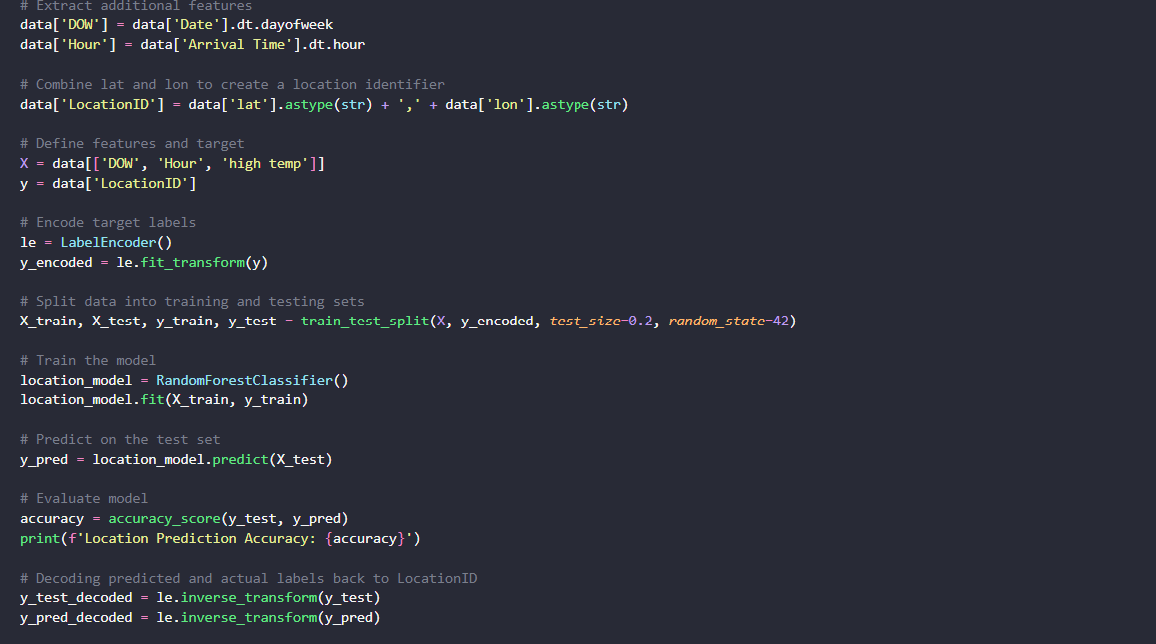
Code
Random forest Classifier
Constructs multiple decision trees during training and outputs the average prediction (regression) of the individual trees.
Each decision tree is trained on a random subset of the data, and the final prediction is made by averaging the predictions of all trees.
Random Forests work well with tabular data and can handle non-linear relationships by partitioning the data space.
They are robust to overfitting, especially when the number of trees is large, and they provide feature importance, which is useful for understanding the model's decisions.

Slide 5

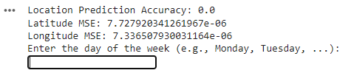
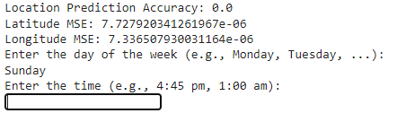
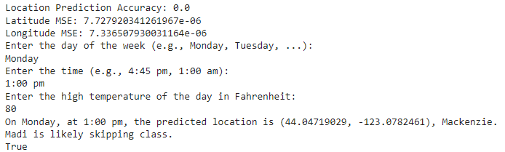
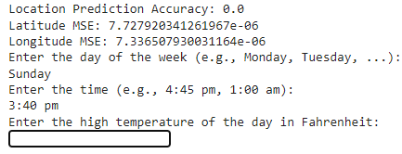
Example of Output and its Code
Users prompted to enter day of the week and hour of the day they would like to find Madi
Prints out a statement with the address, and lat lon of where she is predicted to be

Slide 6

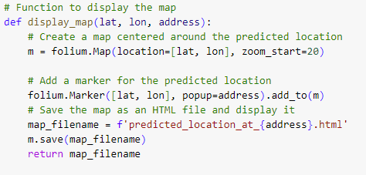
Example of Map Code and Output
Used package folium
Used the predicted lat lon to map the marker
Saves the map to an html

